Slide 1
The Structural Simulation Toolkit (SST)
ISPASS 2024
Presented by: Patrick Lavin and Joseph Kenny Sandia National Laboratories
Content by: SST Team
Indianapolis, Indiana
Sunday, May 5
SAND2024-02470C

Slide 2


Instructors
Patrick Lavin prlavin@sandia.gov
Joseph Kenny jpkenny@sandia.gov

Slide 3
Welcome!
Part 1: Introduction to SST 8:00 – 9:30
SST Overview
Basic Simulation in SST
A Tour of SST Elements
Break 9:30 – 9:45
Part 2: Advanced Node-Level Simulation 9:45 – 10:30
Part 3: System-Scale Simulation 10:30 - 12:00

Slide 4
Learning Objectives – Part 1: Introduction to SST
This section of the tutorial will cover the following topics:
The basic structure of the SST project
How to run a simulation in SST
How to view the statistics from your simulation
How to find information about components with sst-info
A summary of the many available components
Where to get more info and help

Slide 5
Codespaces
We will use Github Codespaces for this tutorial.
Everyone with a Github account receives 180 free core hours and 15 free gigabytes of storage every month.
https://github.com/sstsimulator/sst-tutorials
Click “Code”
”Codespaces”
“...”
“New with options”
Dev container configuration -> “ispass2024”
“Create codespace”
Alternate instructions are available at https://github.com/sstsimulator/sst-tutorials/tree/master/ispass2024
You may also want to open https://github.com/sstsimulator/sst-elements in another tab

Slide 6
Container
The codespace automatically loads our container from Dockerhub
Includes SST, and the simulation components required for this tutorial
The codespace also includes you a copy of the sst-tutorials repository, so you can edit the files we will work on
Try it out: `sst`
We didn’t give it an input file so it can’t simulate anything yet!

Slide 7
References
Websites
Information on installing SST, and links to everything else you see here
http://www.sst-simulator.org/
Documentation on SST’s key interfaces, overview of all the elements, and more!
http://sst-simulator.org/sst-docs/
Code
https://github.com/sstsimulator
Important Pages
Configuration File Format: http://sst-simulator.org/SSTPages/SSTUserPythonFileFormat/
Doxygen Documentation: http://sst-simulator.org/SSTDoxygen/13.0.0_docs/html/
Developer FAQ: http://sst-simulator.org/SSTPages/SSTTopDocDeveloperInfo/
Building SST
Quick start: http://sst-simulator.org/SSTPages/SSTBuildAndInstall_13dot1dot0_SeriesQuickStart/
Detailed: http://sst-simulator.org/SSTPages/SSTBuildAndInstall_13dot1dot0_SeriesDetailedBuildInstructions/

Slide 8
Part 1: Introduction to SST

Slide 9
SST Overview

Slide 10

Motivation: Interoperability
There is a rich selection of open-source simulators
But not a solid ecosystem for modeling systems
Tightly-entangled components make modifications complex
E.g., assumptions about caching or address mapping are pervasive
Most simulator integrations are ad-hoc, not lasting
Significant performance problems with tying many simulators together
Wants:
Enable “mix-and-match” of existing models to create custom systems
Encourage disentangled models with clean interfaces for swapping functionality
Bricks not buildings
Low effort, high performance parallel simulation
Continuous path from low-fidelity/fast modeling to high-fidelity/slow models

Slide 11



The Structural Simulation Toolkit
Goals
Create a standard architectural simulation framework for HPC*
Ability to evaluate future systems on DOE/DOD workloads
Use supercomputers to design supercomputers
Status
Parallel framework (SST Core)
Integrated libraries of components (Elements)
Current Release (13.1.0)
Two releases per year
Consortium
“Best of Breed” simulation suite
Used in industry, academia, and at labs
Technical Approach
Parallel Discrete Event core
With conservative optimization over MPI/Threads
Interoperability
Node and system-scale models
Multi-scale
Detailed (~cycle) and simple models that interoperate
Open
Open Core, non-viral, modular

Slide 12
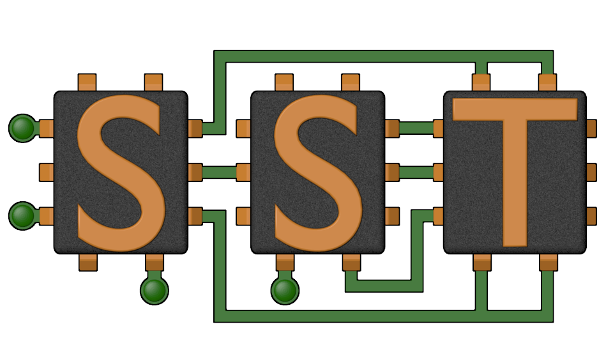
The SST Approach
Parallel Discrete-Event Simulator Framework (SST Core)
Flexible framework enables multitude of custom “simulators”
Demonstrated scaling to over 512 processors running a million+ components
Comes with many built-in simulation models (SST Elements)
Processors, memories, networks
Open API
Easily extensible with new models
Modular framework
Open-source core
Time-scale independent core
Handles Micro-, Meso-, Macro-scale simulations
C++, Python

Slide 13
SST Architecture
SST Core framework
The backbone of simulation
Provides utilities and interfaces for simulation components (models)
Clocks, event exchange, statistics and parameter management, parallelism support, etc.
SST Element libraries
Libraries of components that perform the actual simulation
Elements include processors, memory, network, etc.
Includes many existing simulators: DRAMSim2, Spike, HMCSim, Ramulator, etc.
Component
Component
Component
Component
Processor
Cache
DRAM
NoC
Integration Services
Links, Clocks, etc.
SST Core
SST Core
MPI and C++ Threads
MPI and C++ Threads

Slide 14
Building Blocks
SST simulations are comprised of components
Components are connected by links
Every link has a minimum (non-zero) latency
Components define ports which are valid connection points for a link
Components communicate by sending events over the links
Components can use subcomponents and modules for customizable functionality
Component
Core
Component
Core
Event
Load
Link
Link
Component
Cache
Component
Cache
Event
Data
SubComponent
Prefetcher
Link
Link
Component
NoC Router
Component
NoC Router
Link
Element Library
A collection of components, subcomponents, and/or modules

Slide 15

SST Code Structure
SST Core and SST Elements are compiled separately
Element libraries register with the core
External elements (not part of SST Elements) can also be registered with the core
Example at github.com/sstsimulator/sst-external-element
Core maintains a database of registered libraries
Can query database with sst-info utility
Source code for core:
sst-core/src/sst/core/
Source code for elements
sst-elements/src/sst/elements/
Most elements have a tests/ directory
sst-elements/src/sst/elements/SomeComponent/tests
Often a good starting point for example configurations
Component
Component
Component
Component
Integration Services
SST Core
MPI and C++ Threads

Slide 16
Basic SST Simulation

Slide 17
Our First Simulation – demo_1.py
Simulated System
We’ll walk through how to configure a simulation and then run it
Available at: (sst-tutorials → ispass2024 → exercises → single-node )
Element libraries in our example simulation
Miranda - Simple core model that runs generated instruction streams
Generators produce memory access patterns (SubComponent)
memHierarchy – Various cache/memory system related subcomponents and modules
Cache (Component) with coherence protocol SubComponent
Memory Controller (Component) that loads a memory timing model (SubComponent)
gen
core
cache
memory
memctrl
These names match the variables in demo_1.py

Slide 18
Configuration File: Global SST parameters
Set any global simulation parameters
Other options
Most command line options to SST are able to be set using setProgramOption()
import sst
##########################
## Define SST core options
##########################
# If this demo gets to 100ms, something # has gone very wrong!
sst.setProgramOption("stop-at", "100ms")
SST Python API
User-defined string
SST argument
Option | Definition
debug-file | File to print debug output to
heartbeat-period | If set, SST will print a heartbeat message at the specified period
print-timing-info | Tells SST to print timing information from the run
partitioner | Partitioner to use for parallel execution
output-partition | File to print partition to

Slide 19
Configuration File: Declare components
SST Python API
User-defined string
SST argument
Components: sst.Component(“name”, “type”)
gen
######################
## Declare components
######################
core = sst.Component(“core”, “miranda.BaseCPU”)
cache = sst.Component(“cache”, “memHierarchy.Cache”)
memctrl = sst.Component(“memory”, “memHierarchy.MemController”)
core
cache
memctrl
mem
Component name
Element library

Slide 20

Configuration File: Configure the core
SST Python API
User-defined string
SST argument
Parameters: addParams({ “parameter” : “value”, … })
########################################################
## Set component parameters and fill subcomponent slots
########################################################
core.addParams({
"clock" : "2.4GHz",
"max_reqs_cycle" : 2,
})
gen
core
cache
memctrl
mem
How do I know what the options are? Or even what elements I can pick from?
sst-info

Slide 21
Aside: sst-info
Use sst-info to find information about all registered elements.
$ sst-info miranda.baseCPU
PROCESSED 1 .so (SST ELEMENT) FILES FOUND IN DIRECTORY(s) [...]
================================================================================
ELEMENT LIBRARY 0 = miranda ()
Components (1 total)
Component 0: BaseCPU
Description: Creates a base Miranda CPU ready to execute an address generator/access pattern
ELI version: 0.9.0
Compiled on: Dec 1 2023 14:33:14, using file: mirandaCPU.h
Category: PROCESSOR COMPONENT
Parameters (12 total)
max_reqs_cycle: Maximum number of requests the CPU can issue per cycle (this is for all reads and writes) [2] ...

Slide 22
Configuration File: Add a subcomponent
SST Python API
User-defined string
SST argument
SubComponents: setSubComponent(“slotname”, “type”)
Recall: SubComponent is a swappable piece of functionality
gen
gen = core.setSubComponent("generator", "miranda.STREAMBenchGenerator")
gen.addParams({
"n" : 1000, # Number of array elements
})
core
cache
memctrl
mem

Slide 23
Configuration File: Configure the cache
SST Python API
User-defined string
SST argument
cache.addParams({
"L1" : 1,
"cache_frequency" : "2.4GHz",
"access_latency_cycles" : 2,
"cache_size" : "2KiB",
"associativity" : 4,
"replacement_policy" : "lru",
"coherence_policy" : "MESI",
"cache_line_size" : 64,
})
gen
core
cache
memctrl
mem

Slide 24
Configuration File: Configure the memory controller
SST Python API
User-defined string
SST argument
memctrl.addParams({
"clock" : "1GHz",
"backing" : "none", # No real memory values, just addresses
"addr_range_end" : 1024*1024*1024-1,
})
memory = memctrl.setSubComponent("backend", "memHierarchy.simpleMem")
memory.addParams({
"mem_size" : "1GiB",
"access_time" : "50ns",
})
gen
core
cache
memctrl
mem

Slide 25
Configuration File: Declare and connect
Links: sst.Link(“name”)
#######################################
## Declare links
#######################################
core_cache = sst.Link("core_to_cache")
cache_mem = sst.Link("cache_to_memory")
########################################
## Connect components with the links
########################################
core_cache.connect( (core, "cache_link", "100ps"), (cache, "high_network_0", "100ps") )
cache_mem.connect( (cache, "low_network_0", "100ps"), (memctrl, "direct_link", "100ps") )
gen
core
Link name
cache
memctrl
mem

Slide 26
Configuration File: Connect links
Connect components: connect(endpoint1, endpoint2)
Where endpoint is: (component, port, latency)
gen
########################################
## Connect components with the links
########################################
core_cache.connect( (core, "cache_link", "100ps"), (cache, "high_network_0", "100ps") )
cache_mem.connect( (cache, "low_network_0", "100ps"), (memctrl, "direct_link", "100ps") )
core
Endpoint 1
cache
Endpoint 2
memctrl
mem
How do I remember the port names?

Slide 27
SSTInfo: Getting component info
sst-info: utility to query element libraries
Optionally filter for a specific library and/or component
$ sst-info memHierarchy.Cache
PROCESSED 1 .so (SST ELEMENT) FILES FOUND IN DIRECTORY(s) /home/sst/build/lib/sst
Filtering output on Element = “memHierarchy.Cache”
================================================================================
ELEMENT LIBRARY 0 = memHierarchy ()
Component 2: Cache
Description: Cache controller
Parameters (41 total)
cache_frequency: (string) Clock frequency or period with units (Hz or s; SI units OK) [<required>]
cache_line_size: (uint) Size of a cache line (aka cache block) in bytes. [64]
…
Ports (10 total)
low_network_0: Port connected to lower level caches (closer to main memory)
…
Statistics (43 total)
TotalEventsReceived: Total number of events received, (units = "events") Enable level = 1
…
“REQUIRED” or default value
Parameter
Definition
Port name
Definition
Name
Definition
Units
Enable Level

Slide 28
Running SST
Usage: sst [options] configFile.py
Common options:
-h | --help | Print complete list of command line options
-v | --verbose | Print information about core runtime
--debug-file <filename> | Send debugging output to specified file (default: sst_output)
--partitioner <self | simple | rrobin | linear | lib.partitioner_name> | Specify the partitioning mechanism for parallel runs
-n | --num_threads <num> | Specify number of threads per rank
--model-options “<args>” | Command line arguments to send to the Python configuration file. Any arguments after a final – will be appended to the model-options.
--output-partition <filename> | Write partitioning information to <filename>
--output-dot <filename> --output-xml <filename> --output-json <filename> | Output the configuration graph in various formats to <filename>
Notes:
Is this still up to date?

Slide 29
Running a simulation
Launch simulation
Output
We probably want more information about what happened though
Enable statistics!
$ sst demo_1.py
Simulation is complete, simulated time: 6.80711 us

Slide 30
Enabling statistics
Most Components and SubComponents define statistics
Enable statistics in the configuration file
enableAllStatisticsForAllComponents()
enableAllStatisticsForComponentType(type)
enableAllStatisticsForComponentName(name)
setStatisticLoadLevel(level)
Configure output
setStatisticOutput(“sst.output_type”)
setStatisticOutputOptions({“option” : “value”, })
$ sst-info memHierarchy.Cache
…
Statistics (43 total)
TotalEventsReceived: Total number of events received, (units = "events") Enable level = 1
CacheHits: Total number of cache hits, (units = count) Enable Level = 1
latency_GetS_hit: Latency for read hits, (units = cycles) Enable level = 1
enableStatisticForComponentName(name, stat)
enableStatisticForComponentType(type, stat)

Slide 31
Running with statistics enabled
Let’s enable statistics for all components
Caches have A LOT of statistics so send the output to a CSV file
Other options: sst.statoutputX where X=
console
json
txt
hdf5
sst.setStatisticOutput(“sst.statoutputcsv”)
sst.setStatisticOutputOptions({ “filepath” : “stats.csv” })
sst.setStatisticLoadLevel(5)
sst.enableAllStatisticsForAllComponents()

Slide 32
Running a Simulation – Add Statistics
Copy configuration
Add statistics to new configuration
Launch simulation
Take a minute to look at the statistics
Can you calculate the L1 memory bandwidth?
$ cp demo_1.py demo_2.py
What should you add?
$ sst demo_2.py

Slide 33
SST in parallel
MPI Rank 0
Comp0
Comp2
Comp4
Comp6
SST was designed from the ground up to enable
scalable, parallel simulations
Components distributed among MPI ranks/threads
Link latency controls synchronization rate
Sadly, MPI is not supported in our container
Comp1
Comp3
Comp5
Comp7
# Two ranks
$ mpirun –np 2 sst demo_1.py
# Two threads
$ sst –n 2 demo_1.py
# Two ranks with two threads each
# This will give a warning since we only
# have 3 components across 4 ranks/threads
$ mpirun –np 2 sst –n 2 demo_1.py
Same configuration file
MPI Rank 0
MPI Rank 1
MPI Rank 2
MPI Rank 3
Comp0
Comp2
Comp4
Comp6
Comp1
Comp3
Comp5
Comp7
Notes:
Links handle serialization

Slide 34
A Tour of SST Elements

Slide 35

SST Element Libraries
Elements are libraries of related components
Elements must be registered with the SST core
Tells SST where to find this set of components
Includes information on parameters and statistics for each component
SST provides a set of element libraries
Processor, network, memory, etc.
Tested for interoperability within and across libraries
Many are compatible with external “components” such as Ramulator and Spike
You can also register your own elements
Example: https://github.com/sstsimulator/sst-external-element

Slide 36
(A few) SST 13.1 Elements
Processors
Ariel – PIN-based
Prospero – trace execution
Miranda – pattern generator
Vanadis – MIPS32 and RV64 pipeline
GeNSA – Spiking temporal processing unit
Osseous – RTL simulation
Memory Subsystem
MemHierarchy – caches, directory, memory
CacheTracer – cache tracing
Cassini – cache prefetchers
CramSim – DDR, HBM
Messier – NVM
Samba – TLB
VaultSim – vaulted stacked memory
Network drivers
Ember – communication patterns
Firefly – communication protocols
Hermes – MPI-like driver interface
Zodiac – trace based driver
Thornhill – memory models for Ember
Networks/NoCs
Merlin – flexible network modeling
Kingsley – mesh NoC
Shogun – crossbar NoC
Accelerators
Balar – GPGPU-Sim interface
Llyr – spatial compute
Others
sst-macro → Mercury
simpleElementExample
simpleSimulation

Slide 37
Processor Models
Elements:
Ariel
Prospero
Miranda
Vanadis

Slide 38

Ariel: PIN-based processor
$ sst-info ariel.ariel
Lightweight processor core model
Uses Intel’s PIN tools and XED decoders to analyze binaries
Runs x86, x86-64, SSE/AVX, etc. binaries
Supports fixed thread count parallelism (OpenMP, Qthreads, etc.)
Passes instructions to virtual core in SST
Pin
x86 Binary
Binary
Instruction
trace
Ariel CPU
SST
Core
Core
Core
Core
GPGPU-Sim Integration
Processor
Memory
Network/NoC
Network driver
Other

Slide 39
Ariel: Details
$ sst-info ariel.ariel
Pintool communicates with Ariel via shared memory IPC
Per-thread FIFO of instructions from pintool to Ariel’s virtual cores
Backpressure on FIFO halts the binary’s execution
Ariel’s virtual cores
Memory instruction oriented: execute memory instructions; other ins. single cycle no-ops
Clocked: Reads instruction stream in chunks but processes on clock
Does not maintain dependence order or register locations
Can map virtual-to-physical addresses internally or use external component
Key parameters
Ops issued/cycle
Load/store queue size
Uses SST standardMem interface
Generates StandardMemRequests
Compatible with memHierarchy
Processor
Memory
Network/NoC
Network driver
Other

Slide 40
Ariel: The Tradeoff
$ sst-info ariel.ariel
Pros:
Faster than more complex/pipeline models
Reasonable approximation for studies on memory system performance
Especially for heavily memory-bound applications
Reasonable model of thread interactions
Cons
Non-deterministic results
Interactions between pintool, threads, etc.
Variation is low (O(1%))
Not compatible with non-x86 binaries
Reliant on Pin
Ongoing work to enable other frontends
Processor
Memory
Network/NoC
Network driver
Other

Slide 41
Prospero: Trace-based processor
$ sst-info prospero.prosperoCPU
Trace-based processor model
Like Ariel, memory instruction oriented
Reads memory ops from a file and passes to the simulated memory system
“Single core” but can use multiple trace files to emulate threaded or MPI applications
Supports arbitrary length reads to account for variable vector widths
Performs “first touch” virtual to physical mapping
Comes with Prospero Trace Tool to generate traces
Or can generate your own and translate to Prospero’s format
Processor
Memory
Network/NoC
Network driver
Other

Slide 42
Prospero: The Tradeoff
$ sst-info prospero.prosperoCPU
Pros
Faster than Ariel*
Provided you can get a trace
Cons
Traces can be very large
Requires good I/O system to store and read the trace
Traces are less flexible than actual execution
Capture a single execution stream using a single application input
Processor
Memory
Network/NoC
Network driver
Other

Slide 43
Miranda: Pattern-based processor
$ sst-info miranda.BaseCPU
Extremely light-weight processor model
Generates memory address patterns
Supports request dependencies
Library patterns
Strided accesses (single stream)
Forward and reverse strides
Random accesses
GUPS
STREAM benchmark
In-order & out-of-order CPU
3D stencil
Sparse matrix vector multiply (SpMV)
Copy (~array copy)
Stake interface to the Spike RiscV simulator
Ongoing work to integrate Spatter patterns
Processor
Memory
Network/NoC
Network driver
Other

Slide 44
Miranda: The tradeoffs
$ sst-info miranda.BaseCPU
Pros
Very lightweight – no binary, no trace
Good for applications whose address patterns are predictable
e.g., not much pointer-chasing
Models instruction dependences
Cons
Need a generator for the memory pattern of interest
Requires a good understanding of the pattern
Processor
Memory
Network/NoC
Network driver
Other

Slide 45
Vanadis: OOO Processor
$ sst-info vanadis.VanadisNodeOS
MPIS32 and RV64 compatible processor model
OOO model
Configure micro-architectural details
Instruction fetch/decode/retire rate
ROB size
Branch prediction
Multi-threaded cores
Musl libc used to cross-compile programs
Also tested with clang
System-call emulation
Processor
Memory
Network/NoC
Network driver
Other

Slide 46
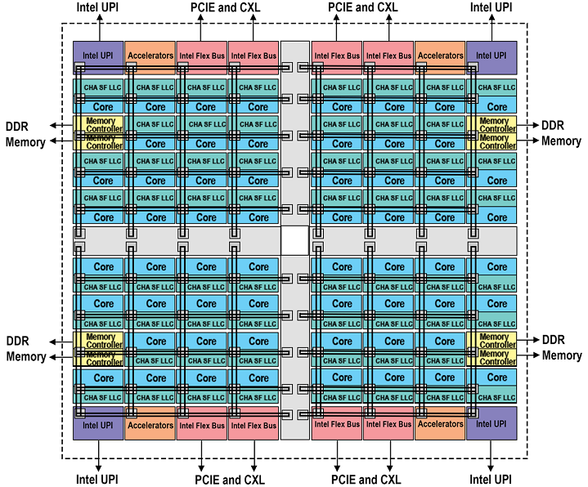
SOCs
What if you wanted something much more complex? Can SST simulate a core with SMT? What about something like a modern processor? SPR? EPYC?
https://www.intel.com/content/www/us/en/developer/articles/technical/fourth-generation-xeon-scalable-family-overview.html
https://www.amd.com/content/dam/amd/en/documents/epyc-technical-docs/white-papers/58015-epyc-9004-tg-architecture-overview.pdf

Slide 47
Single-core Vanadis
Let’s start simple…
RISC-V core
I-Cache
D-Cache
L2 Cache
Memory

Slide 48
Single-core Vanadis
What attributes can we change in the core model?
$ sst-info vanadis
Parameters (35 total)
verbose: Set the level of output verbosity, 0 is no output, higher is more output [0]
dbg_mask: Mask for output. Default is to not mask anything out (0) and defer to 'verbose'. [0]
start_verbose_when_issue_address: Set verbose to 0 until the specified instruction address is issued, then set to 'verbose' parameter []
stop_verbose_when_retire_address: When the specified instruction address is retired, set verbose to 0 []
pause_when_retire_address: If specified, the simulation will stop when this address is retired. [0]
pipeline_trace_file: If specified, a trace of the pipeline activity will be generated to this file. []
max_cycle: Maximum number of cycles to execute. The core will halt after this many cycles. [std::numeric_limits<uint64_t>::max()]
node_id: Identifier for the node this core belongs to. Each node in the system needs a unique ID between 0 and (number of nodes) - 1. Used to tag output. [0]
core_id: Identifier for this core. Each core in the system needs a unique ID between 0 and (number of cores) - 1. [<required>]
hardware_threads: Number of hardware threads in this core [1]
clock: Core clock frequency [1GHz]
reorder_slots: Number of slots in the reorder buffer [64]
physical_integer_registers: Number of physical integer registers per hardware thread [128]
physical_fp_registers: Number of physical floating point registers per hardware thread [128]
integer_arith_units: Number of integer arithemetic units [2]
integer_arith_cycles: Cycles per instruction for integer arithmetic [2]
integer_div_units: Number of integer division units [1]
integer_div_cycles: Cycles per instruction for integer division [4]
fp_arith_units: Number of floating point arithmetic units [2]
fp_arith_cycles: Cycles per floating point arithmetic [8]
fp_div_units: Number of floating point division units [1]
fp_div_cycles: Cycles per floating point division [80]
branch_units: Number of branch units [1]
branch_unit_cycles: Cycles per branch [int_arith_cycles]
issues_per_cycle: Number of instruction issues per cycle [2]
fetches_per_cycle: Number of instruction fetches per cycle [2]
retires_per_cycle: Number of instruction retires per cycle [2]
decodes_per_cycle: Number of instruction decodes per cycle [2]
dcache_line_width: Width of a line for the data cache, in bytes. (Currently not used but may be in the future). [64]
icache_line_width: Width of a line for the instruction cache, in bytes [64]
print_retire_tables: Print registers during retirement step (default is yes) [true]
print_issue_tables: Print registers during issue step (default is yes) [true]
print_int_reg: Print integer registers true/false, auto set to true if verbose > 16 [false]
print_fp_reg: Print floating-point registers true/false, auto set to true if verbose > 16 [false]
print_rob: Print reorder buffer state during issue and retire [true]

Slide 49
Single-core Vanadis
What attributes can we change in the core model?
$ sst-info vanadis
Default Parameter
Parameters (Purged a Few…)
clock: Core clock frequency [1GHz]
reorder_slots: Number of slots in the reorder buffer [64]
physical_integer_registers: Number of physical integer registers per hardware thread [128]
physical_fp_registers: Number of physical floating point registers per hardware thread [128]
integer_arith_units: Number of integer arithemetic units [2]
integer_arith_cycles: Cycles per instruction for integer arithmetic [2]
integer_div_units: Number of integer division units [1]
integer_div_cycles: Cycles per instruction for integer division [4]
fp_arith_units: Number of floating point arithmetic units [2]
fp_arith_cycles: Cycles per floating point arithmetic [8]
fp_div_units: Number of floating point division units [1]
fp_div_cycles: Cycles per floating point division [80]
branch_units: Number of branch units [1]
branch_unit_cycles: Cycles per branch [int_arith_cycles]
issues_per_cycle: Number of instruction issues per cycle [2]
fetches_per_cycle: Number of instruction fetches per cycle [2]
retires_per_cycle: Number of instruction retires per cycle [2]
decodes_per_cycle: Number of instruction decodes per cycle [2]

Slide 50
Single-core Vanadis
Let’s start simple…
Ok, not so simple but the structure is similar to all SST configurations
$ cat basic_vanadis.py
$ sst no_rtr_vanadis.py

Slide 51
Multi-core Vanadis
What if we want to make something more complex?
3x2 mesh
CPUs at 1, 3, 4, 5
Memory at 0, 2

Slide 52
Multi-core Vanadis
What if we want to make something more complex?
This looks frightening but isn’t that bad…
$ cat boom_vanadis-kingsley.py
$ sst boom_vanadis-kingsley.py

Slide 53
Vanadis: The tradeoffs
$ sst-info vanadis.VanadisNodeOS
Pros
Runs binaries
Detailed model of instruction dependencies
Cons
Slower than other models
Processor
Memory
Network/NoC
Network driver
Other

Slide 54
Memory
Elements:
memHierarchy

Slide 55
MemHierarchy: Memory system
$ sst-info memHierarchy | grep " Component"
Collection of interoperable memory system elements
Caches
Directories
Memory controllers
Interfaces to memory models (DDR, HBM, HMC, NVM, etc.)
Scratchpads
NoC (network-on-chip) interfaces
Buses
Components are cycle-accurate/cycle-level
Capable of modeling modern cache and memory subsystems
Memory
Processor
Network/NoC
Network driver
Other

Slide 56
MemHierarchy: Cache modeling
$ sst-info memHierarchy.Cache
Highly configurable
Arbitrary hierarchy depth, flexible topologies
Cache inclusivity, coherence, private/shared, etc. configurable
Single- and multi-socket configurations
Prefetch via Cassini element library
Data movement
Components support direct, bus, and on-chip network (NoC) communication
Event types: read/write, atomics, LLSC, noncacheable, custom memory, etc.
Memory
Processor
Network/NoC
Network driver
Other

Slide 57
MemHierarchy: Memory modeling
$ sst-info memHierarchy.MemController
Interface to memory is the MemController
MemControllers implement backends
These do the actual work of timing memory access
Can be interfaces to other memory simulators
More on the next slide
Support custom memory instructions
Including ability to do cache shootdowns for coherence maintenance
Memory
Processor
Network/NoC
Network driver
Other

Slide 58
MemHierarchy: Memory modeling
$ sst-info memHierarchy.MemController
Memory controller
Manages data values if needed (backing store)
Facilitates custom memory commands
Including cache shootdowns for coherence maintenance
Passes events to memory backend subcomponent
Backend: the “real” memory controller and/or memory
Implementations
Memory controller and model itself
Memory controller with interface to a memory component
Interface to another memory controller/memory component
Wrapper to an external simulator
Memory Controller
Backing store
Custom command handler
Backend
To memory component (optional)
Memory
Processor
Network/NoC
Network driver
Other

Slide 59
MemHierarchy: SST 13.1 backends
Memory (external)
CramSim (DDR, HBM)
DRAMSim3 DDR, LPDDR, GDDR HBM, HMC, STT-MRAM)
FlashDIMMSim (FLASH)
HMCSim/GoblinHMC (HMC)
Messier (NVRAM)
Ramulator (DDR, HBM, HMC)
SimpleDRAM (DDR)
SimpleMem (constant latency)
TimingDRAM (DDR)
VaultSimC (HMC-like)
Plus a few that can be used with other backends to reorder requests, add latency, etc.
Memory
Processor
Network/NoC
Network driver
Other

Slide 60
Running a Simulation – Add Components, L2 Cache
Copy configuration
Add an L2 cache between L1 and memory to new configuration
What parameters are available for an L2 cache?
What are appropriate values for the parameters?
Launch simulation
How did this affect your overall simulated time?
How did this affect traffic to and from your backing store?
$ cp demo_2.py demo_3.py
What should you add?
$ sst demo_3.py

Slide 61
Running a Simulation – Switch Components, Timing DRAM
Copy configuration
Switch the simpleMem subcomponent for timingDRAM
Launch simulation
How do your results differ from the run with simpleMem?
$ cp demo_3.py demo_4.py
What should you change? Remember that sst-info is your pal!
$ sst demo_4.py

Slide 62
Networks
Elements:
Merlin
Kingsley

Slide 63
Merlin: Network simulator
$ sst-info merlin
Low-level networking components that can be used to simulate high-speed networks (machine level) or on-chip networks
Capabilities
High radix router model (hr_router)
Topologies – mesh, n-dim tori, fat-tree, dragonfly,
Many ways to drive a network
Simple traffic generation models
Nearest neighbor, uniform, uniform w/ hotspot, normal, binomial
MemHierarchy
Lightweight network endpoint models (Ember – coming up next)
Or, make your own
Network/NoC
Processor
Memory
Network driver
Other

Slide 64
Merlin: Organization
$ sst-info merlin
Router
NIC
PC
XBAR
PC
TrafficGen
TestNIC
User Logic
LC
PC
PC
PC
PC
LC = LinkControl
PC
PC
Topology
PC = PortControl
Network/NoC
Processor
Memory
Network driver
Other

Slide 65
Kingsley: Mesh simulator
$ sst-info kingsley
Network-on-chip model; mesh configuration
Similar to Merlin but:
No input queuing at routers
Mesh topology only
Not all ports need to be populated
Possible to instantiate multiple unconnected networks
Multiple physical networks for coherence (e.g., request/response/ack/forward)
Kingsley NoC + Merlin/Kingsley system network
Core
Core
Core
Core
Core
Core
Core
Core
Core
Core
Core
Core
Core
Core
Core
Core
NIC
Interconnect
Network/NoC
Processor
Memory
Network driver
Other

Slide 66
Network Drivers
Elements:
Ember
Firefly
Hermes

Slide 67
Ember: Network Traffic Generator
$ sst-info ember
Light-weight endpoint for modeling network traffic
Enables large-scale simulation of networks where detailed modeling of endpoints would be expensive
Packages patterns as motifs
Can encode a high level of complexity in the patterns
Generic method for users to extend SST with additional communication patterns
Intended to be a driver for the Hermes, Firefly, and Merlin communication modeling stack
Uses Hermes message API to create communications
Abstracted from low-level, allowing modular reuse of additional hardware models
Network driver
Processor
Memory
Network/NoC
Other

Slide 68
Ember: Overview
$ sst-info ember
Ember Motif
High Level Communication Pattern and Logic
Generates communication events
Ember Engine
User
Binary
Event to Message Call, Motif Management
Handles the tracking of the motif
Hermes API
Message Passing Semantics
Collectives, Matching, etc.
Firefly
Packetization and Byte Movement Engine
Generates packets and coordinates with network
Merlin Network
Flit Level Movement, Routing, Delivery
Moves flits across network, timing, etc.
Network driver
Processor
Memory
Network/NoC
Other

Slide 69
Ember: Motifs
$ sst-info ember | grep Motif
Motifs are lightweight patterns of communication
Tend to have very small state
Extracted from parent applications
Models as an MPI program (serial flow of control)
Many motifs acting in the simulation create the parallel behavior
Example motifs
Halo exchanges (1, 2, and 3D)
MPI collections – reductions, all-reduce, gather, barrier
Communication sweeping (Sweep3D, LU, etc.)
Network driver
Processor
Memory
Network/NoC
Other

Slide 70
Ember: Motifs (continued)
$ sst-info ember.EmberEngine
The EmberEngine creates and manages the motif
Creates an event queue which the motif adds events to when probed
The Engine executes the queued events in order, converting them to message semantic calls as needed
When the queue is empty, the motif is probed again for events
Events correspond to a specific action
E.g., send, recv, allreduce, compute-for-a-period, wait, etc.
Network driver
Processor
Memory
Network/NoC
Other

Slide 71
Firefly: Network traffic
$ sst-info firefly
Purpose: Create network traffic, based on application communication patterns, at large scale
Enables testing the impact of network topologies and technologies on application communication at very large scale
Scales to 1 million nodes
Supports multiple “cores” per Node
Interaction between cores limited to message passing
Supports space sharing of the network
Multiple “apps” running simultaneously
Network driver
Processor
Memory
Network/NoC
Other

Slide 72
Firefly: Simulating large networks
$ sst-info firefly
A network node consists of
Driver (the “application”)
NIC
Router
Nodes are connected together via routers to form a network
Fat tree, torus, etc.
Firefly is the interface between the driver and the router
Message passing library → Firefly Hades
NIC → Firefly NIC
Ember
(driver)
Firefly Hades
Firefly NIC
Merlin Router
Network driver
Processor
Memory
Network/NoC
Other

Slide 73
(More) SST 13.1 Elements
Processors
Ariel – PIN-based
Prospero – trace execution
Miranda – pattern generator
Vanadis – MIPS32 and RV64 pipeline
GeNSA – Spiking temporal processing unit
Osseous – RTL simulation
Memory Subsystem
MemHierarchy – caches, directory, memory
CacheTracer – cache tracing
Cassini – cache prefetchers
CramSim – DDR, HBM
Messier – NVM
Samba – TLB
VaultSim – vaulted stacked memory
Network drivers
Ember – communication patterns
Firefly – communication protocols
Hermes – MPI-like driver interface
Zodiac – trace based driver
Thornhill – memory models for Ember
Networks/NoCs
Merlin – flexible network modeling
Kingsley – mesh NoC
Shogun – crossbar NoC
Accelerators
Balar – GPGPU-Sim interface
Llyr – spatial compute
Others
sst-macro → Mercury
simpleElementExample
simpleSimulation

Slide 74
Even More Elements
There are even more elements included, described here:
http://sst-simulator.org/sst-docs/docs/elements/intro
A number of external simulators are compatible with SST.
See section on optional dependencies: http://sst-simulator.org/SSTPages/SSTBuildAndInstall_13dot1dot0_SeriesDetailedBuildInstructions/
Many memory timing simulators are supported by memHierarchy

Slide 75
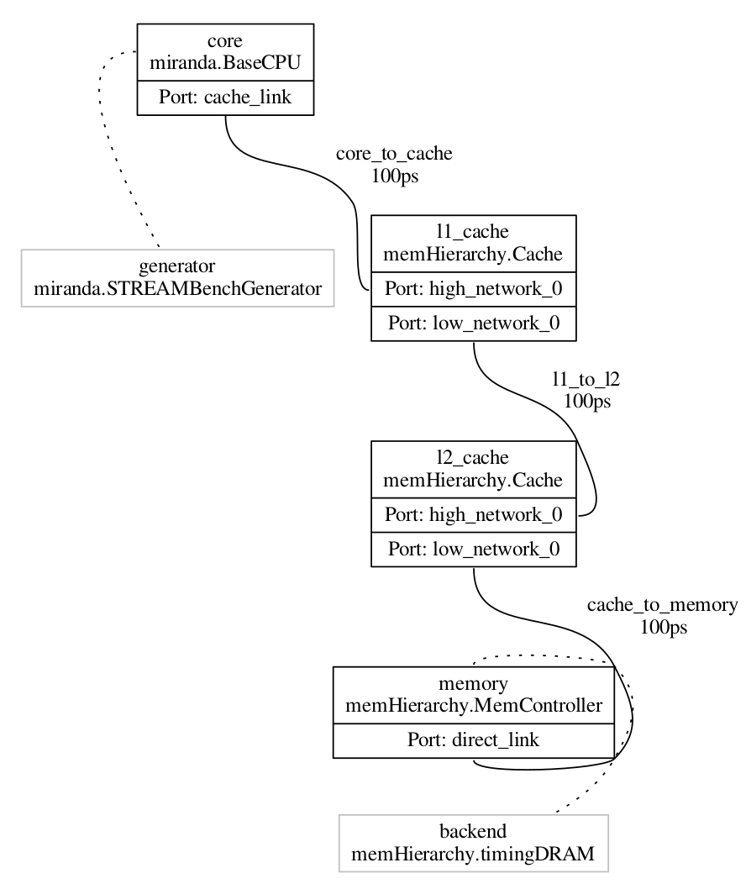
Viewing Configuration Graph
Let’s take a look at how SST views our system
Re-run demo_4 but add a command to dump the configuration graph
This gives you a GraphViz formatted file
You can install a JPEG previewer in VS Code to see the output.
Is this how you expected your system to look?
With this in mind, let’s add a second Miranda core…
$ sst --output-dot=graph_demo_4.dot –dot-verbosity=10 demo_4.py
$ dot –Tjpg graph_demo_4.dot –o graph_demo_4.jpg

Slide 76
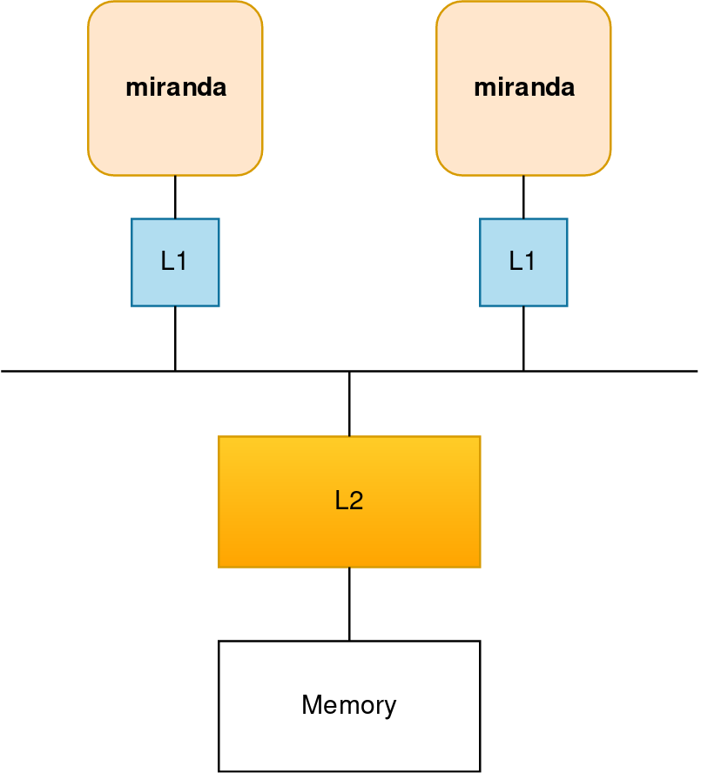
Running a Simulation – Add Components, Second Miranda
Copy configuration
Add an a second Miranda generator
What else might you need?
Dump the wiring diagram to verify the model
Launch simulation
$ cp demo_4.py demo_5.py
How about another L1 cache?
How are you going to wire everything together? How about a bus?
$ sst demo_5.py

Slide 77
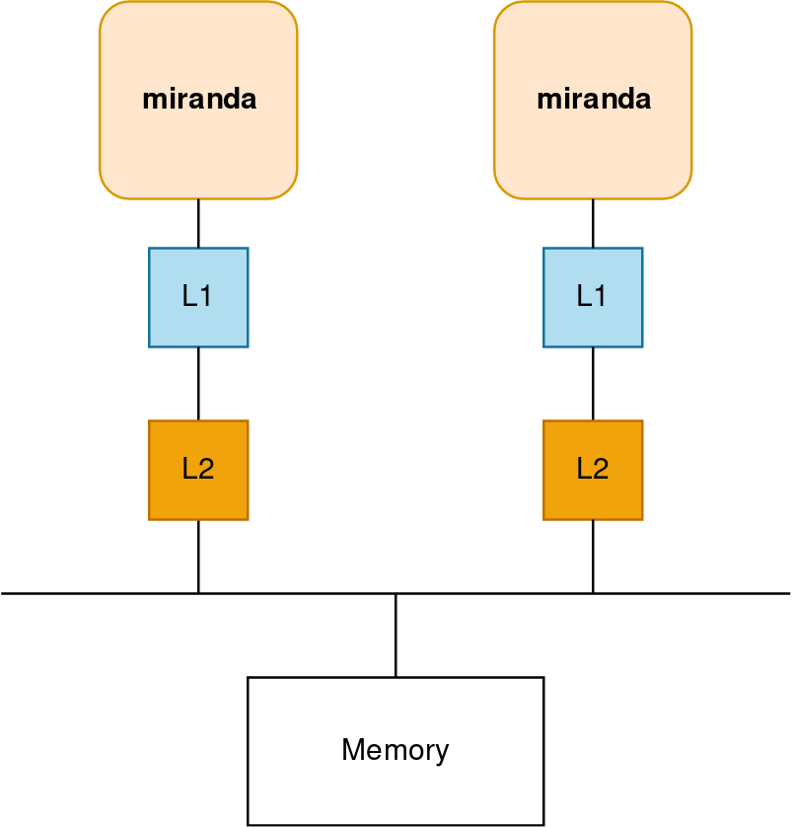
Running a Simulation – Add Components, Second L2
Copy configuration
Add L2 cache and move both above the bus
Launch simulation
$ cp demo_5.py demo_6.py
$ sst demo_6.py

Slide 78
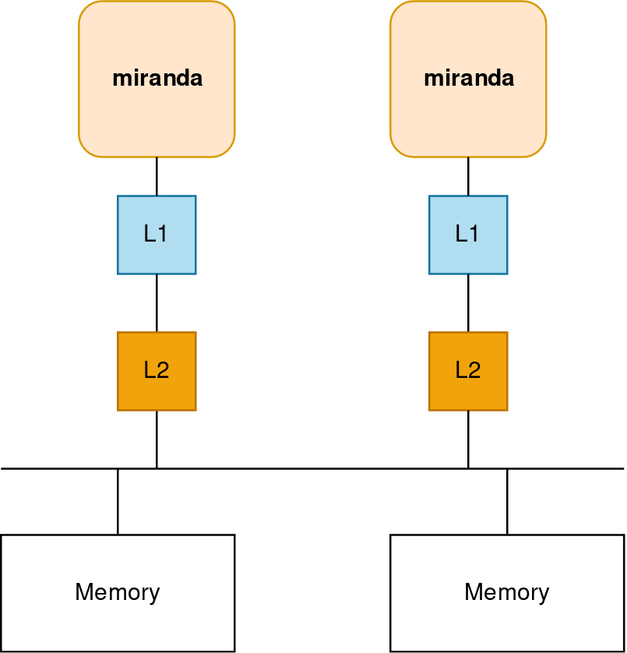
Running a Simulation – Add Components, Secondary Memory
Copy configuration
Add an a second L2 and memory controller
Think carefully about how addressing should will work…
Launch simulation
$ cp demo_6.py demo_7.py
Can you still use a bus?
Can the talk directly to the memory controller?
$ sst demo_7.py

Slide 79
Getting Help & Extending SST

Slide 80
Extending SST
SST was designed for extensibility
Components/subcomponents can be added without touching SST Elements
Example: write a new prefetcher and have memH caches use it → no changes to memHierarchy
SST-Core APIs are stable → one year deprecation period
Element APIs may be less so but generally try to keep them consistent
Many users start with SST Elements and then build their own customized libraries
Partially or completely replacing SST Element functionality
Many approaches to using SST
Core only: Write your own components from scratch
Start from existing Elements and replace components/subcomponents to meet your needs
Wrap existing simulators and insert as components or subcomponents

Slide 81
Extending SST: Resources
Example element library
Components demonstrating links, ports, clocks, event handling, etc.
sst-elements/src/sst/elements/simpleElementExample/
simpleSimulation
Simulates a car wash (a little more complex than example elements)
Example external element library
Demonstrates building and registering a new element library
https://github.com/sstsimulator/sst-external-element

Slide 82
Finally: Getting help
SST website contains lots of information (www.sst-simulator.org)
Downloading, installing, and running SST
Element libraries and external components
Guides for extending SST
Information on APIs
Information about current development efforts
Past tutorial slides and exercises
SST Github
Current development
Issues track user questions as well as development plans, bugs, etc.

Slide 83
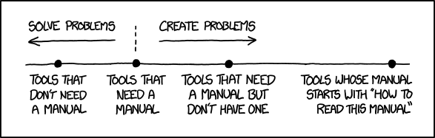
Part 1 wrap-up
SST is a parallel, flexible simulation framework
Can simulate many systems at many granularities
Capable of simulating modern architectures
Modular design for extensibility
Please keep us posted on your uses of SST as well as any capabilities you’ve added or would like to see added
The SST team wants to help you!
Documentation?
Examples?
Kittens?

Slide 84
Welcome!
Part 1: Introduction to SST 8:00 – 9:30
SST Overview
Basic Simulation in SST
A Tour of SST Elements
Break 9:30 – 9:45
Part 2: Advanced Node-Level Simulation 9:45 – 10:30
Part 3: System-Scale Simulation 10:30 - 12:00

Slide 85
Return at 9:45

Slide 86
Welcome!
Part 1: Introduction to SST 8:00 – 9:30
SST Overview
Basic Simulation in SST
A Tour of SST Elements
Break 9:30 – 9:45
Part 2: Advanced Node-Level Simulation 9:45 – 10:30
Part 3: System-Scale Simulation 10:30 - 12:00

Slide 87
Learning Objectives – Part 1: Advanced Node-Level Simulation
This section of the tutorial will cover the following topics:
How to wire up a more modern memory hierarchy
How to simulate an OOO processor with Vanadis

Slide 88
Advanced memHierarchy

Slide 89
Advanced memHierarchy Configuration
Lets do something a bit more realistic.
Let’s model a processor with
Split LLC
Multiple NUMA domains
2D mesh network
We will keep the simple core model, Miranda

Slide 90
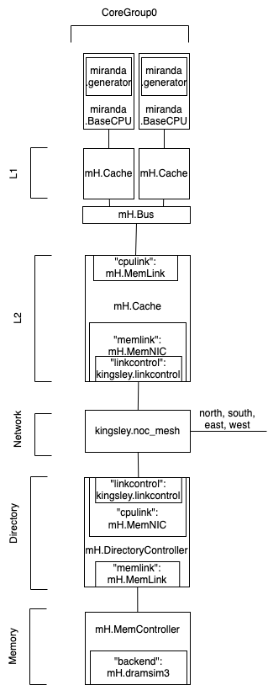
numa.py
To the right is a single core group
A core has its own L1D cache
Each group of cores shares an L2
In the middle, the NOC router will connect to others
At the bottom, the memory needs a directory controller

Slide 91
System-Level Modeling

Slide 92
Welcome!
Part 1: Introduction to SST 8:00 – 9:30
SST Overview
Basic Simulation in SST
A Tour of SST Elements
Break 9:30 – 9:45
Part 2: Advanced Node-Level Simulation 9:45 – 10:30
Part 3: System-Scale Simulation 10:30 - 12:00

Slide 93
Learning Objectives – Part 3: System-Level Modeling
This section of the tutorial will cover the following topics:
Detailed description of Merlin, our system-level network simulator
Network simulation interfaces
How to write a new SST element
How to add a new network topology
How to extend the SST python interface to support the new topology

Slide 94
High-level View

Slide 95
Merlin: Network Simulator
Low-level, flexible networking components that can be used to simulate high-speed networks (machine level) or on-chip networks
Capabilities
High radix router model (hr_router)
Topologies – mesh, n-dim tori, fat-tree, dragonfly, hyperx
Many ways to drive a network
Simple traffic generation models
MemHierarchy
Lightweight network endpoint models (Ember)
Or, make your own

Slide 96
Merlin High Level Overview
hr_router
hr_router
Topology
Topology
PC
PC
PC
PC
Xbar
Xbar
PC
PC
PC
PC
PC
PC
PC
PC
PC = PortControl
LC = LinkControl
LC
LC
LC
LC
End Point
End Point
End Point
End Point

Slide 97
General Parameters
General
link_bw – bandwidth of the network links (in B/s or b/s)
hr_router
xbar_bw – per port bandwidth into router crossbar (in B/s or b/s)
flit_size – size of a flit (in B or b)
input_latency – input latency of router (in s)
output_latency – output latency of router (in s)
xbar_arb – crossbar arbitration unit to be used
hr_router/LinkControl
input_buf_size – size of input buffer for router/NIC (in B or b)
output_buf_size – size of output buffer for router/NIC (in B or b)

Slide 98
LinkControl – Endpoint Facing
Inherits from SST::Interfaces::SimpleNetwork
bool send(SST::Interfaces::SimpleNetwork::Request* req, int vn);
bool spaceToSend(int vn, int flits);
SST::Interfaces::SimpleNetwork::Request* recv(int vn);
bool requestToReceive( int vn ) { return ! input_buf[vn].empty(); }
void sendUntimedData(SST::Interfaces::SimpleNetwork::Request* ev);
SST::Interfaces::SimpleNetwork::Request* recvUntimedData();
void setNotifyOnReceive(HandlerBase* functor) { receiveFunctor = functor; }
void setNotifyOnSend(HandlerBase* functor) { sendFunctor = functor; }
bool isNetworkInitialized() const { return network_initialized; }
nid_t getEndpointID() const { return id; }
const UnitAlgebra& getLinkBW() const { return link_bw; }

Slide 99
SimpleNetwork::Request
class Request : public SST::Core::Serialization::serializable {
public:
nid_t dest; /*!< Node ID of destination */
nid_t src; /*!< Node ID of source */
int vn; /*!< Virtual network of packet */
size_t size_in_bits; /*!< Size of packet in bits */
bool head; /*!< True if this is the head of a stream */
bool tail; /*!< True if this is the tail of a steram */
private:
Event* payload; /*!< Payload of the request */
public:
inline void givePayload(Event *event);
inline Event* takePayload();
inline Event* inspectPayload();
protected:
TraceType trace;
int traceID;

Slide 100
LinkControl-PortControl Interactions
LinkControl and PortControl share data and negotiate various parameters during the init() phase
Each LC/PC pair will negotiate link bandwidth. It is set to the minimum of the two set bandwidths
PortControl will notify the LinkControl of the network ID used to address it
PortControl will report FLIT size to the LinkControl
LinkControl notifies PortControl of the desired Virtual Networks to be used
This is a deprecated feature. Number of VNs is now set directly through the router
The LinkControl and PortControl objects manage send credits

Slide 101
PortControl/LinkControl Statistics
packet_latency (LC only)
For each packet, adds latency to statistics object (side effect is that it counts the number of packets received at an endpoint)
send_bit_count
For each packet, adds the size in bits to the statistics object (side effect is that it counts number of packets sent on a port)
output_port_stalls
For each interval where data is present, but can’t be sent due to lack of send credits, add the time stalled to statistics object
idle_time (PC only for now)
For each interval where no data is present to be sent, add total idle time to statistics object

Slide 102
ReorderLinkControl
Inherits from SST::Interfaces::SimpleNetwork
Contains a SimpleNetwork interface object to talk to the “physical” layer (this is typically just a LinkControl).
Puts a sequence number on each packet and reorders packets on the receive-side before giving them to endpoint
Allows endpoint models that can’t handle out of order receipt of packets to use network models that don’t guarantee ordering
Currently assumes “infinite” resources for buffer and reordering

Slide 103
Crossbar Arbitration
xbar_arb_rr
Round robin allocation – first across ports, then across virtual channels
xbar_arb_lru
Least recently used – across all port/VC pairs
xbar_arb_age
Oldest packets get higher priority
xbar_arb_rand
Random priority assigned to each port/VC pair each arbitration cycle

Slide 104
Topology Module
Router knows nothing about topology/routing without loading a topology module
Can use static and/or dynamic routing
Available topologies
SingleRouter
Mesh
Torus
Fattree
HyperX/Flattened Butterfly
Dragonfly
PolarFly/PolarStar

Slide 105
Topology Class – More on this later
virtual void route_packet(int port, int vc, internal_router_event* ev) = 0;
virtual internal_router_event* process_input(RtrEvent* ev) = 0;
virtual PortState getPortState(int port) const = 0;
bool isHostPort(int port) const;
virtual std::string getPortLogicalGroup(int port) const;
virtual void routeInitData(int port, internal_router_event* ev, std::vector<int> &outPorts) = 0;
virtual internal_router_event* process_InitData_input(RtrEvent* ev) = 0;
virtual int computeNumVCs(int vns);
virtual int getEndpointID(int port);
virtual void recvTopologyEvent(int port, TopologyEvent* ev);

Slide 106
Configuring a Merlin Simulation

Slide 107
Merlin/Ember Python Modules
Merlin and Ember provide built-in Python modules to make configuring simulations easier
Wires up the topology based on user supplied parameters
Allows simulated jobs (endpoint models) to be easily allocated to the network
The Python modules are built off of five primary base classes:
System – Overall system with functions to allocated jobs and build the simulation
Topology – Controls the network topology and parameters
RouterTemplate – Allows the ability to swap in different router models
In practice, there is only one current model: hr_router
Job – Jobs are mapped to the system using the job allocation functions and contains all the parameters for running the given job on the system
PlatformDefinition – allows you to capture all or part of the platform parameters and load them into a simulation instead of having to repeat this information in every input file

Slide 108
Ember – Lightweight Network Endpoint
Ember Motif
High Level Communication Pattern and Logic
Generates communication events
Ember Engine
User
Binary
Event to Message Call, Motif Management
Handles the tracking of the motif
Hermes API
Message Passing Semantics
Collectives, Matching, etc.
Firefly
Packetization and Byte Movement Engine
Generates packets and coordinates with network
Merlin Network
Flit Level Movement, Routing, Delivery
Moves flits across network, timing, etc.

Slide 109
Block Diagram of Python Network Configuration Classes
System
Topology
Allocation
Jobs
net_if
net_if
net_if
Router
Template

Slide 110
System
After configuring the System, the build() function is called to generate the configuration graph. Configuration options (some of these can be set in a PlatformDefinition file):
topology: set the topology to use. See next slide for available topologies
allocation_block_size: sets the number of contiguous endpoints that will be used for allocation. Only currently used when simulating multiNIC nodes
Allocate jobs to system: jobs are allocated using the allocateNodes() function. The following allocation algorithms can be used, and each job can use a different allocation using the remaining nodes in system:
Random – randomly allocate ranks to the available nodes
Linear – allocate nodes in order based on number used by topology
Random-linear – allocate linearly in a randomly selected subset of nodes
Interval – allocate N nodes every M endpoints (this is handy for reserving nodes for things like I/O nodes in the network)
Indexed – provide a list of ordered endpoints to allocate the job to (all endpoints in the list must still be unallocated in the system)

Slide 111
Topology
Controls the topology and all the high level network parameters (for example link bandwidth). The build function is called during the System.build() function
Can set the type of router to use by setting MyTopology.router, or can use the default (hr_router)
Supported topologies:
Dragonfly – uses 1D all-to-all groups
Hyperx - can be of any dimension, with any number of links per dimension
Fattree – built using individual routers (no support for consolidated routers)
Mesh/Torus – can be of any dimension, with any number of links per dimension
SingleRouter – just a single router (used mostly to mimic crossbars on chip)

Slide 112
Topology: Mesh/Torus
Implements an N-dimensional torus or mesh
shape
Gives the number of routers in each dimension
Examples: 16x16x16, 4x4x4x4x4
width
Gives number of links between routers in each dimension
Example: 1x1x1, 4x8x4, 3x3x3x3x3
local_ports
Gives number of hosts connected to each router
// Create a Torus topology
topology = topoTorus()
// Set shape to 3D torus with 16 routers per
// dimension
topology.shape = “16x16x16”
// 8 links between routers in each dimension
topology.width = “8x8x8”
// 16 endpoints per router
topology.local_ports = 16

Slide 113
Topology: HyperX/Flattened Butterfly
Implements and N-dimensional hyperX/flattened butterfly
shape
Gives the number of routers in each dimension
Examples: 16x16x16, 4x4x4x4x4
width
Gives number of links between routers in each dimension
Example: 1x1x1, 4x8x4, 3x3x3x3x3
local_ports
Gives number of hosts connected to each router
// Create a hyperX topology
topology = topoHyperX()
// Set shape to 3D torus with 16 routers per
// dimension
topology.shape = “16x8x16”
// Keep same bisection BW for each dimension
// by doubling links in small dimension
topology.width = “1x2x1”
// 16 endpoints per router
topology.local_ports = 16

Slide 114
Topology: Dragonfly
Implements a dragonfly topology with fully connected local group
hosts_per_router
Number of hosts connected to each router
routers_per_group
Number of routers per local group
intergroup_links
Number of links between each pair of groups
intragroup_links
Number of links between each router pair in a group
num_groups
Total number of groups in the topology
algorithm
Routing algorithm to use
minimal, min-a, valiant, ugal
Total number of hosts is:
hosts_per_router * routers_per_group * num_groups
// Create a dragonfly topology
topology = topoDragonFly()
// Set network parameters
topology.hosts_per_router = 16
topology.routers_per_group = 16
topology.intragroup_links = 2
topology.intergroup_links = 8
topology.num_groups = 32
// Set the routing algorithm
topology.algorithm = “ugal”
// Get the total number of nodes
num_nodes = topology.getNumNodes()

Slide 115
Topology: Fattree
Implements an N-level fattree
shape
Specifies the number of up and down ports at each level of the fattree. Equal up and down links indicates no bandwidth tapering, while unequal numbers indicated tapering. Highest level only specified down links:
Specified down,up:down,up:down,up:down
Total number of nodes is computed by multiplying all the ”downs” together
Examples:
18,18:18,18:36 (largest 3 level fattree using 36 port router with 11,664 hosts)
24,12:18,18:18 (3 level fattree with 50% bandwidth taper out of first level with 7,776 hosts)
These logically match typical fattrees, but are not necessarily physically the same (for example, does not consolidate routers at top level when not all ports are used in each router)

Slide 116
RouterTemplate
Controls which router model is used when the topology is built.
Router parameters are set on the RouterTemplate object. For hr_router, the main parameters are:
If using the default router, you can access the parameters of the RouterTemplate object as follows:
MySystem.topology.router.link_bw = “100 Gbps”
MySystem.topology.router.input_buf_size = “12 kiB”
link_bw
flit_Size
xbar_bw
num_vns
input_latency
output_latency
input_buf_size
output_buf_size

Slide 117
Job
The Ember Python module uses the Job abstraction to easily configure Ember jobs using the Merlin network models.
To configure a set of motifs using MPI, use EmberMPIJob
Constructor takes the following parameters:
job_id – unique ID to identify the job
num_nodes – number of network endpoints to use in the system
numCores – number of cores (MPPI ranks) per node to simulate
nicsPerNode – number of NICs to simulate per node
Each rank will get mapped to only one NIC, and numCores must divide evenly by nicsPerNode
The System allocation block size must be a multiple of the nicsPerNode
Must set the nic parameter to be the network interface corresponding to the router used in topology (for hr_router either LinkControl or ReorderLinkControl)
Add motifs to the job using the addMotif() function. Examples:
myJob.addMotif(“Halo3D26 pex=32 pey=32 pez=32 nx=20 ny=20 nz=20 iterations=1”)
myJob.addMotif(“Allreduce”)
There are a large number of other parameters which are best set in a PlatformDefinition file (see next slide)

Slide 118
PlatformDefinition
The various objects in the simulation will “subscribe” to a set of named parameters and class types that can be used to configure the simulation objects, which can set using the PlatformDefinition interface:
PlatformDefinition.loadPlatformFile(”firefly_platform")
Loads a python file that contains platform definitions
Platform files can contain more than on platform definition
Multiple platform files can be loaded
PlatformDefinition.setCurrentPlatform(”firefly-platform-base")
Set the specified definition as the current platform (can only load one platform at a time)
PlatformDefinition.compose(platformName, …)
Allows you to compose multiple PlatformDefinitions into a new PlatformDefinition
For example, ember parameters and network definition can come from different platform files and be composed together since you can only have one active platform
Platform files can be provided by Sandia, vendors, etc.

Slide 119
Example Configuration using Ember

Slide 120
Example Configuration: merlin-ember-example.py
# Import base sst module
import sst
# Import necessary merlin modules
from sst.merlin.base import *
from sst.merlin.endpoint import *
from sst.merlin.interface import *
from sst.merlin.topology import *
from sst.ember import *
# Include the firefly defaults to get default
# parameters for NIC and network stack
PlatformDefinition.setCurrentPlatform(
"firefly-defaults")
# Setup the topology
topo = topoDragonFly()
topo.hosts_per_router = 2
topo.routers_per_group = 4
topo.intergroup_links = 2
topo.num_groups = 4
topo.algorithm = ”ugal"]
topo.link_latency = "20ns"
# Set up the routers
router = hr_router()
router.link_bw = "4GB/s"
router.flit_size = "8B"
router.xbar_bw = "6GB/s"
router.input_latency = "20ns"
router.output_latency = "20ns"
router.input_buf_size = "4kB"
router.output_buf_size = "4kB"
router.num_vns = 1
router.xbar_arb = "merlin.xbar_arb_lru"
# Add router template to topology
topo.router = router

Slide 121
Example Configuration: merlin-ember-example.py
# Set up the network interface
networkif = ReorderLinkControl()
networkif.link_bw = "4GB/s"
networkif.input_buf_size = "4kB"
networkif.output_buf_size = "4kB"
# Create the ember job
ep = EmberMPIJob(0,topo.getNumNodes())
ep.network_interface = networkif
ep.addMotif("Init") # required first motif
ep.addMotif("Allreduce")
ep.addMotif("Fini") # required last motif
ep.nic.nic2host_lat= "100ns"
# Create the system object
system = System()
system.setTopology(topo)
# Allocate the job using linear placement
system.allocateNodes(ep,"linear")
# Build the system
system.build()
% sst merlin-ember-example.py
Allreduce: ranks 32, loop 1, 1 double(s), latency 5.192 us
Simulation is complete, simulated time: 18.7055 us

Slide 122
Hands On with Merlin and Ember
Things to try:
Change the ember motif being run; possible other motifs to run:
Halo3d26
sweep3D
Change some of the network parameters
link_bw, input/output latencies, etc
Use a different routing algorithm
minimal, min-a, or valiant
Try random allocation of the job
Double the size of the network and add a second job
Try different allocations (linear, random, random-linear)

Slide 123
Extending the functionality of Merlin

Slide 124
Creating a new topology for Merlin
Two approaches to adding functionality to merlin
Add features to the merlin library directly and submit changes for merging
Create an external element library with the changes and distribute library as a third party plug-in
Merlin installs all header files necessary to create a new implementation of its SubComponent APIs
When adding a new topology, there are two main pieces of functionality to implement:
C++ simulation model inheriting from Merlin::Topology
Defined in sst/elements/merlin/router.h
Python configuration help class inherited from merlin.base.Topology
Defined in sst/elements/merlin/pymerlin-base.py
Making this Python module available to the interpreter through the ELI requires you to create a C++ class inheriting from SST::SSTElementPythonModule
Defined in sst/core/model/element_python.h

Slide 125
Example: Ring Topology
Simple ring topology with multiple links between routers and multiple endpoints connected to each router
Topology Parameters:
num_routers – total number of routers
interrouter_links – number of links between routers
local_ports – number of hosts per router
X links between routers
Y hosts connected to each router

Slide 126
Let’s look at the code: archimedes element library
Makefile – Makefile to build the libarchimedes.so element library
topo_ring.h – Header file for the ring topology object and events
topo_ring.cc – Source file for the ring topology implementation
Also includes code to register the archimedes python module with SST core
pyarchimedes.py – Implementation of the archimedes Python module
ring_test.py – Input file to test the ring topology

Slide 127
Hands on: Modify topology to include cross links
Try adding cross links to the topology to cut average hop count in half.
May want to limit topology to even number of routers only
Will need to modify:
Routing function in SubComponent model
Depending on implementation, may need to modify some of the other functions in topo_ring class.
_build_impl() function in the Python template class
X links between routers
Y hosts connected to each router

Slide 128


Thanks!
Exceptional Service In The National Interest

Slide 129
Join Us!
We are always looking for new staff and new collaborations…
Design challenges in the post-exascale era requires that we draw from a diverse pool of talent across multiple disciplines!
If you’re interested, check out https://www.sandia.gov/careers/career-possibilities/career-opportunities/computer-science/, or contact Clay at chughes@sandia.gov

Slide 130
Backup

Slide 131
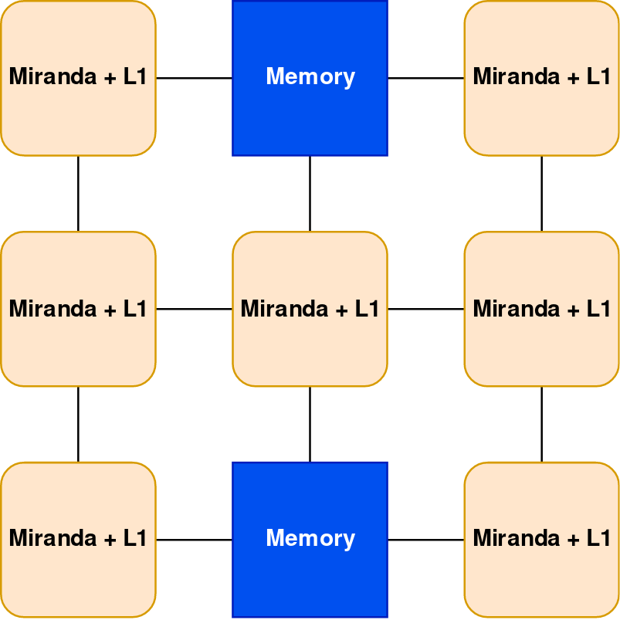
Running a Simulation – Add Components, Simple Node
Copy configuration
Add the components to create a simple node
Each PE has a Miranda generator and an L1
The two memory nodes should use timingDRAM
How should you connect everything?
Launch simulation
$ cp demo_6.py demo_7.py
$ sst demo_7.py

Slide 132
Juno: Simple instruction processor
Executes a program written in simple “assembly”
32-bit wide instructions with 8 bit op codes
64-bit integer operations
ADD, SUB, DIV, MUL,
AND, OR, XOR, NOT
Jump by register value (JGT-Zero, JLZ-Zero, J-Zero)
Jump up to16 bits in either direction from current PC
Up to 253 user registers
r0 = PC
r1 = data start register
Memory
Juno
Load/Store Unit
Instruction Manager
Register File
Processor
Memory
Network/NoC
Network driver
Other

Slide 133
Building Blocks
SST simulations are comprised of components connected by links
Every link has a minimum (non-zero) latency
Components define ports which are valid connection points for a link
Components communicate by sending events over the links
Components can use subcomponents and modules for customizable functionality
Component
Core
Link
Latency: 1ns
Component
Cache
Link
Latency: 2ns
Component
NoC Router
Event
Load
Event
Data
Element Library
A collection of components, subcomponents, and/or modules
SubComponent
Prefetcher
Link
Latency: 4ns
Component
Core
Link
Latency: 1ns
Component
Cache
Link
Latency: 2ns
Component
NoC Router

Slide 134
Running a Simulation – Add Components, Second Memory
Copy configuration
Add an a second L2 and memory controller
Think carefully about how addressing should will work…
Launch simulation
$ cp demo_6.py demo_7.py
Can you still use a bus?
Can the talk directly to the memory controller?
$ sst demo_7.py

Slide 135
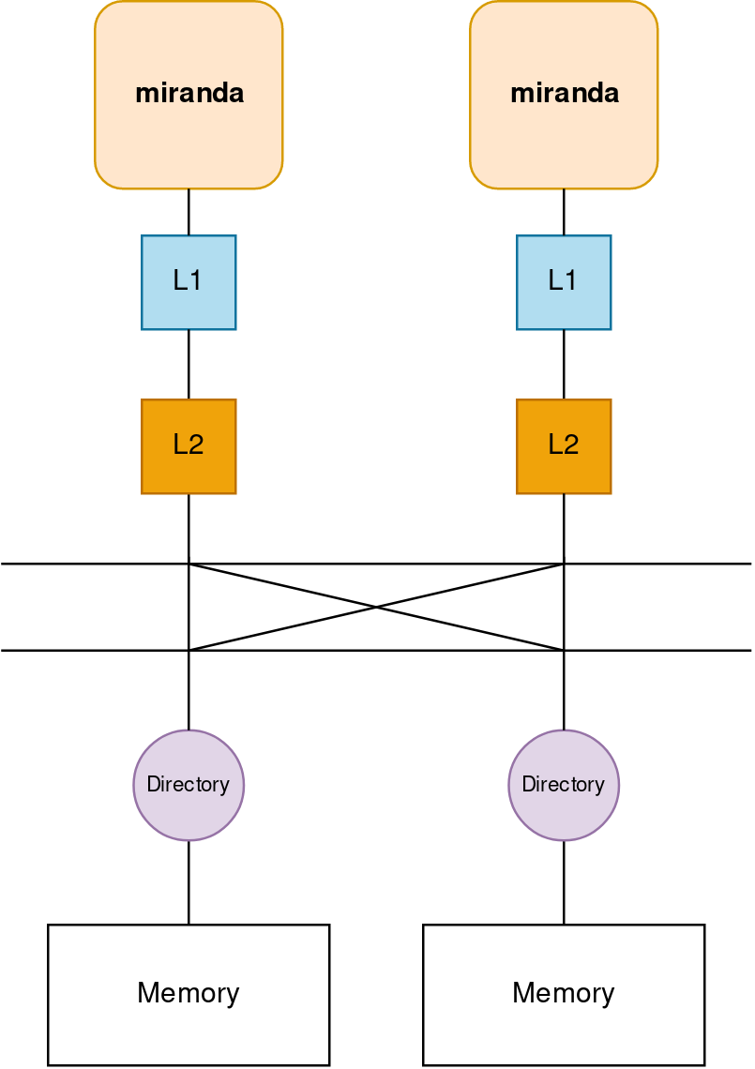
Running a Simulation – Add Components, Second Memory
Swap the bus component for the shogun component
Add directory controllers before the memory
shogun_xbar = sst.Component("shogunxbar", "shogun.ShogunXBar")
shogun_xbar.addParams({
"clock" : "1.0GHz",
"port_count" : 4,
"verbose" : 0
})
dirctrl = sst.Component("dirctrl_" + str(cache_id), "memHierarchy.DirectoryController")
dirctrl.addParams({
"coherence_protocol" : "MESI",
"entry_cache_size" : "32768",
"addr_range_end" : endAddr,
"addr_range_start" : startAddr,
"interleave_size" : "256B",
"interleave_step" : str(numLLC * 256) + "B",
})
dc_cpulink = dirctrl.setSubComponent("cpulink", "memHierarchy.MemNIC")
dc_memlink = dirctrl.setSubComponent("memlink", "memHierarchy.MemLink")
dc_cpulink.addParams({
"group" : 3,
})
dc_linkctrl = dc_cpulink.setSubComponent("linkcontrol", "shogun.ShogunNIC")

Slide 136
Slide Left Blank

